Slide 1
Mars Robotic Curriculum using “Shared World” views
Magdalina Medina
Industrial Engineering
-Human Factors
-Industrial Management Systems

Slide 2
Table of Contents
Introduction
Overview of Project
iRobot
Purpose
Goal
Sample Workings
Coding the iRobot
Student and Teacher Manuals
Recap
Conclusion

Slide 3
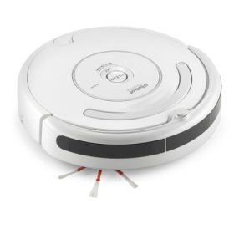
Overview of Project
iRobot
Open robot interface used for its functionalities to be used on Mars
Project Purpose
Create workable robotics curriculum introducing students to “Shared World” views

Slide 4
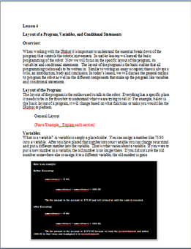
Sample Workings
Project Goals
Examples of Modules
Develop workable modules for science classes
Introduce students to critical and creative problem solving, computer programming and engineering design

Slide 5
Recap of Project
10 modules developed
From Creative and Critical thinking → Terrain Mapping
Goals of being certified through the SETI Institute
Incorporates previous goals mentioned before
Workable interaction with the iRobot
Concludes a positive view of “Shared World” views

Slide 6
Questions and Comments
Mars Robotic Curriculum using “Shared World” views
Magdalina Medina
Industrial Engineering

